Slide 1
RFID BASED AUTOMATED TOLL COLLECTION SYSTEM
“To Make Toll Collection Easier”

Slide 2
Group Intro
Submitted By
Tasmi Khair Tapu(C211218)
Maksura Binte Rabbani Nuha(C211224)
Sabrina Hossain(C211211)
Submitted To
Shahariar Reza
Asst. Lecturer
Department Of CSE, IIUC

Slide 3
Table
Of Content
1
2
3
4
Proposed
Framework
Goals Of Project
Traditional
Vs
Proposed System
Component
5
6
7
8
Block
& Circuit Diagram
Limitation
Future Scope
Conclusion

Slide 4
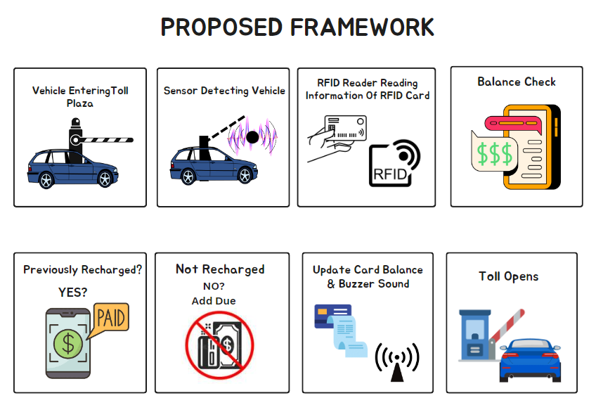

Slide 5
Goals Of Project
To Reduce Traffic Jam Around Toll Collection Booths
To Make a Sensor based Advanced System
To Develop Faster & Accurate Transit
To Reduce Manhour
To Make a Better Toll Booth Management System
To Prevent Corruption

Slide 6
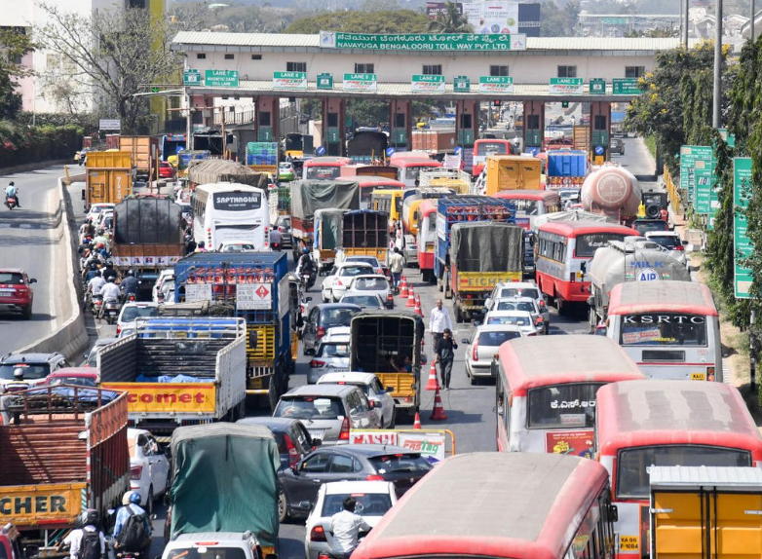
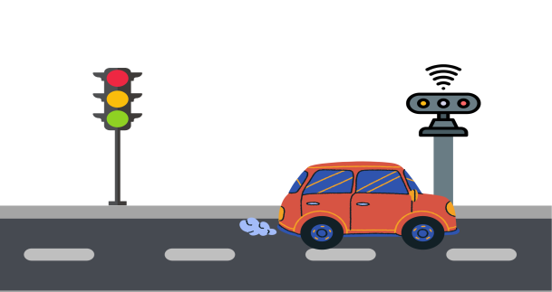


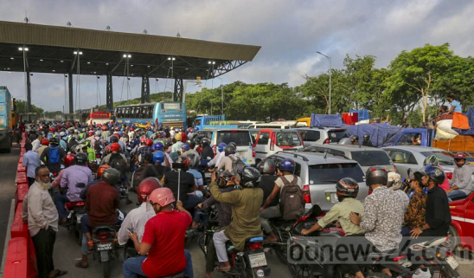
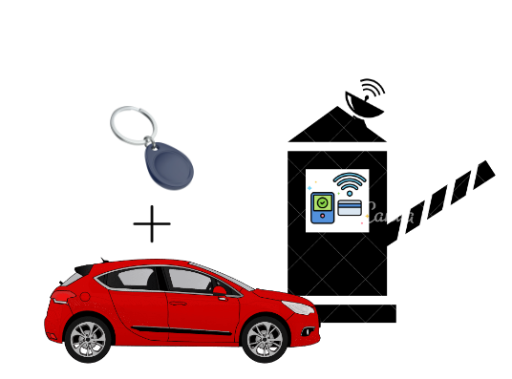
Traditional Vs Proposed System
Traffic Clogging
&
Time Delay
Faster Transit
With
Sensor Detection
Corruption
&
Unnecessary Charges
No Corruption
&
100% Accuracy
Reduction Of Manhour
&
Auto Mechanism
Slower System
&
Fuel Loss

Slide 7
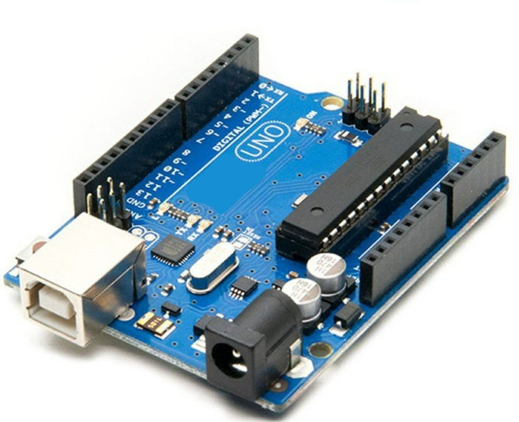
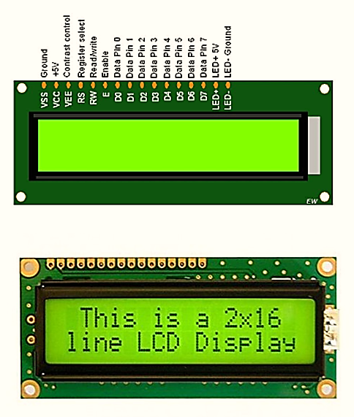
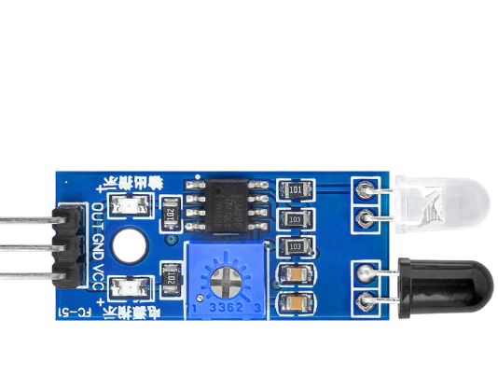
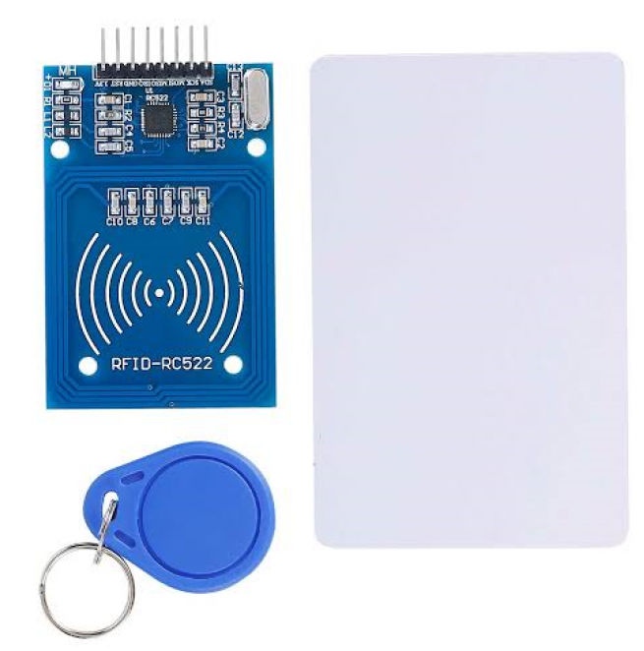
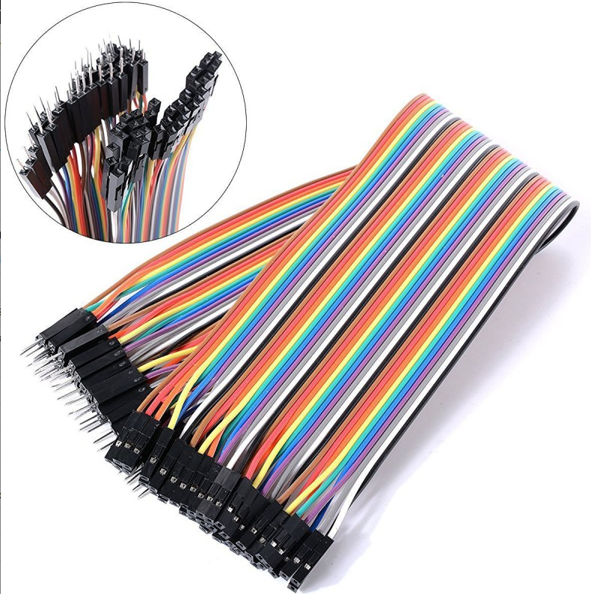
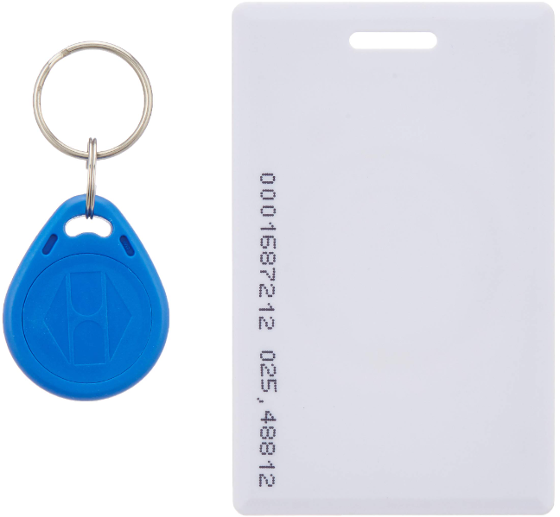
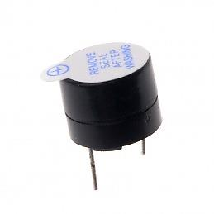
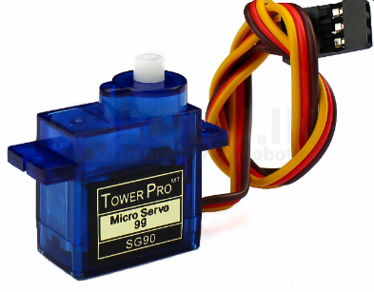
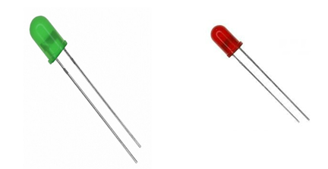
Components
IR Sensor
Arduino UNO
16*2 LCD Display With I2C
RC522 RFID Card Reader Module
RFID TAG & Smart Card
Jumper Wire
Buzzer
Servo Motor
LED Lights

Slide 8
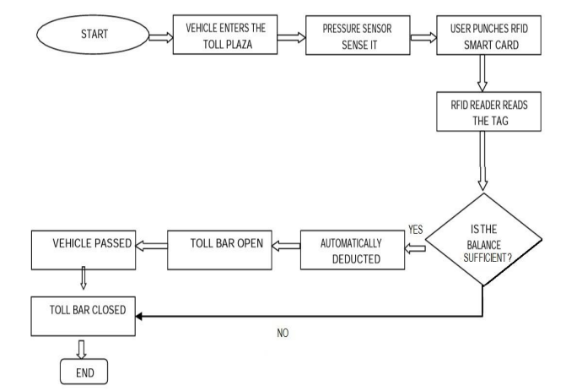
BLOCK DIAGRAM
THE

Slide 9
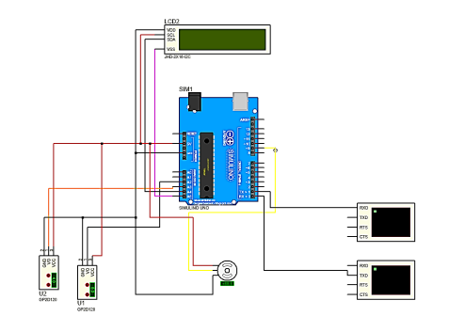
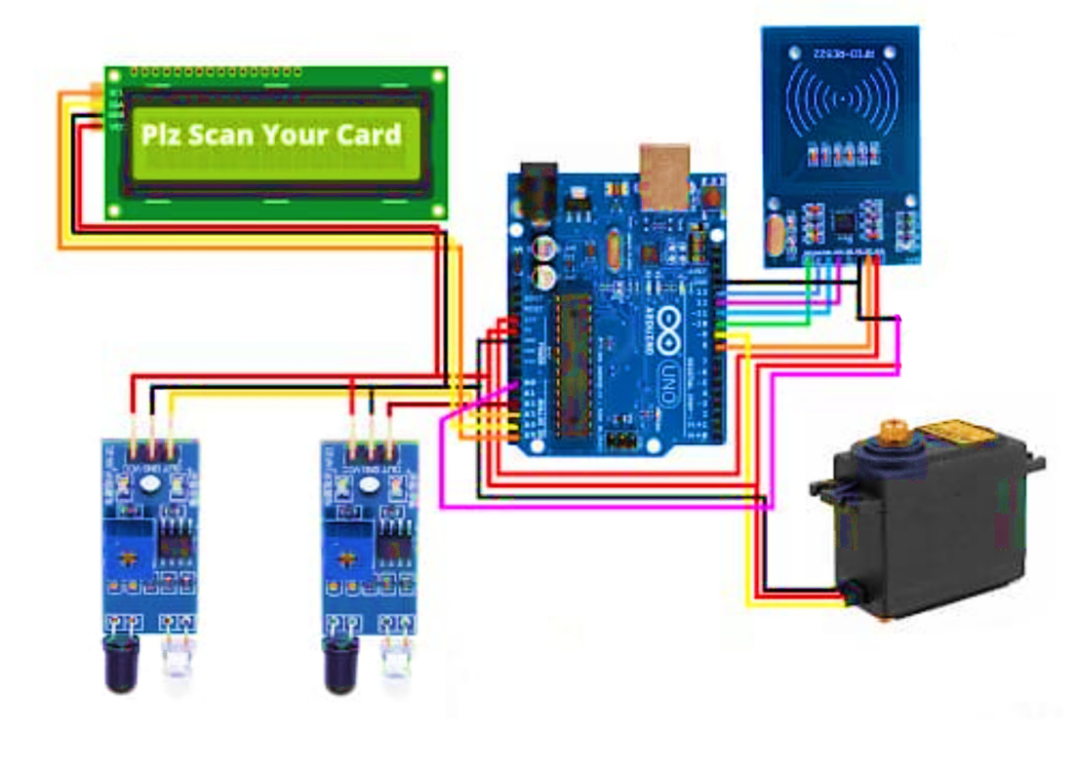
CIRCUIT DIAGRAM

Slide 10
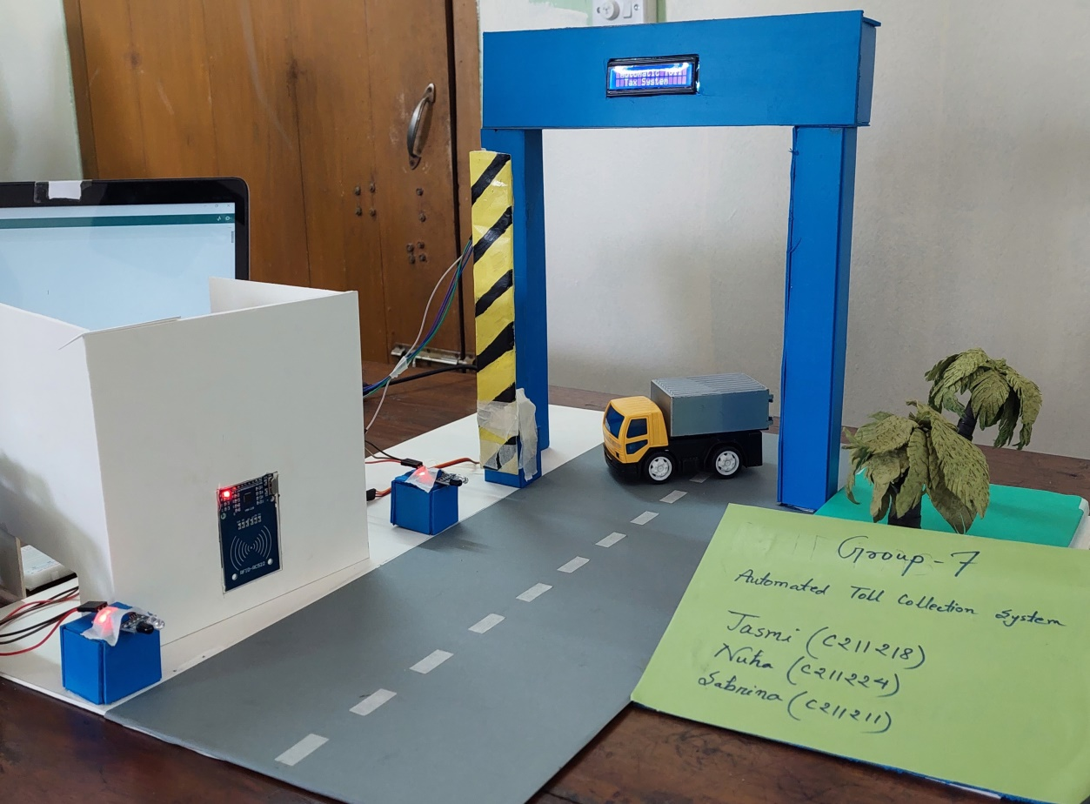
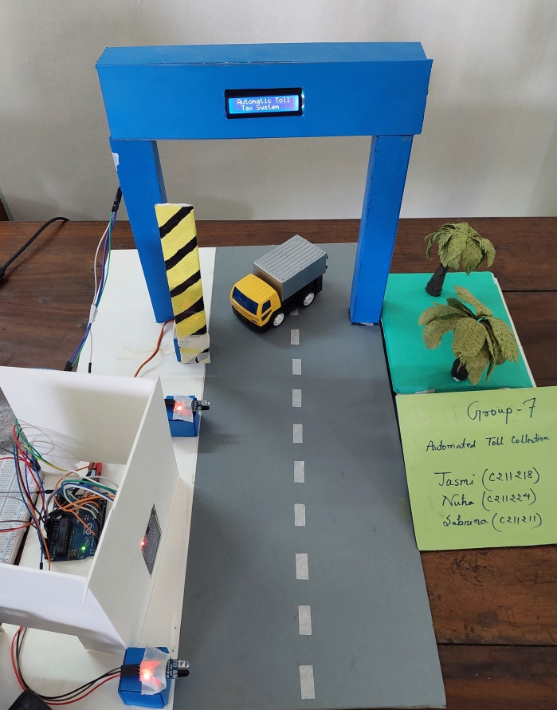
Project Sneak Peek
Project Sneak Peek

Slide 11
Limitation
It cannot detect different weighted vehicles
No Transaction Method Included
High investment Cost

Slide 12
Future Scope
Smart Road System using Speed Meter to reduce road accidents.
Message Alert Service when card doesn’t have sufficient balance.
Usage of Picture Handling or CCTV Camera for Centralize Information Recording to identify vehicles.
A Full Database with Image Processing System

Slide 13
References
[1] Ahmad Zubair, Sourav Mahmood Sagar, Pran Kanai Saha, Shaikh Anowarul Fattah, ” A design for low cost electronic toll collection system with secured data communication,” International Conference on Electrical & Computer Engineering (ICECE 2010), Dhaka, Bangladesh, 18-20 Dec. 2010;
[2] K. Balamurugan, Dr. R. Mahalakshmi, Dr. S. Elangovan and R. Pavithra, “Automatic CheckPost and Fast Track Toll System Using RFID and GSM Module with security System,” IEEE International Conference on Advances in Electrical Technology for Green Energy 2017 (ICAETGT’ 2K17), Coimbatore, India, 23-23 Sept. 2017;
[3] https://en.wikipedia.org/wiki/List_of_roads_in_Bangladesh
[4] https://en.wikipedia.org/wiki/Electronic_toll_collection
[5] https://how2electronics.com/automated-toll-collection-system-using-rfid-arduino

Slide 14
Thank
You

